Slide 1
FEEDBACK CONTROL SYSTEM
LAB # 1
Prepared By :
M. Hammad Saleem
NED University of Engineering & Technology

Slide 2

Part I: Introduction to MATLAB
Objective:
The objective of this exercise will be to introduce you to the concept of mathematical programming using MATLAB.
We shall study how to define variables, matrices etc, see how we can plot results and write simple MATLAB codes.

Slide 3
Topics
Introduction
MATLAB Environment
Getting Help
Variables
Vectors, Matrices, and Linear Algebra
Plotting

Slide 4
Introduction
Q. What is MATLAB ?
• MATLAB is a computer program that combines computation and visualization power that makes it particularly useful tool for engineers.
• MATLAB is an executive program, and a script can be made with a list of MATLAB commands like other programming language.
Q. MATLAB Stands for MATrix LABoratory.
• The system was designed to make matrix computation particularly easy.
Q. The MATLAB environment allows the user to:
• manage variables
• import and export data
• perform calculations
• generate plots
• develop and manage files for use with MATLAB.

Slide 5
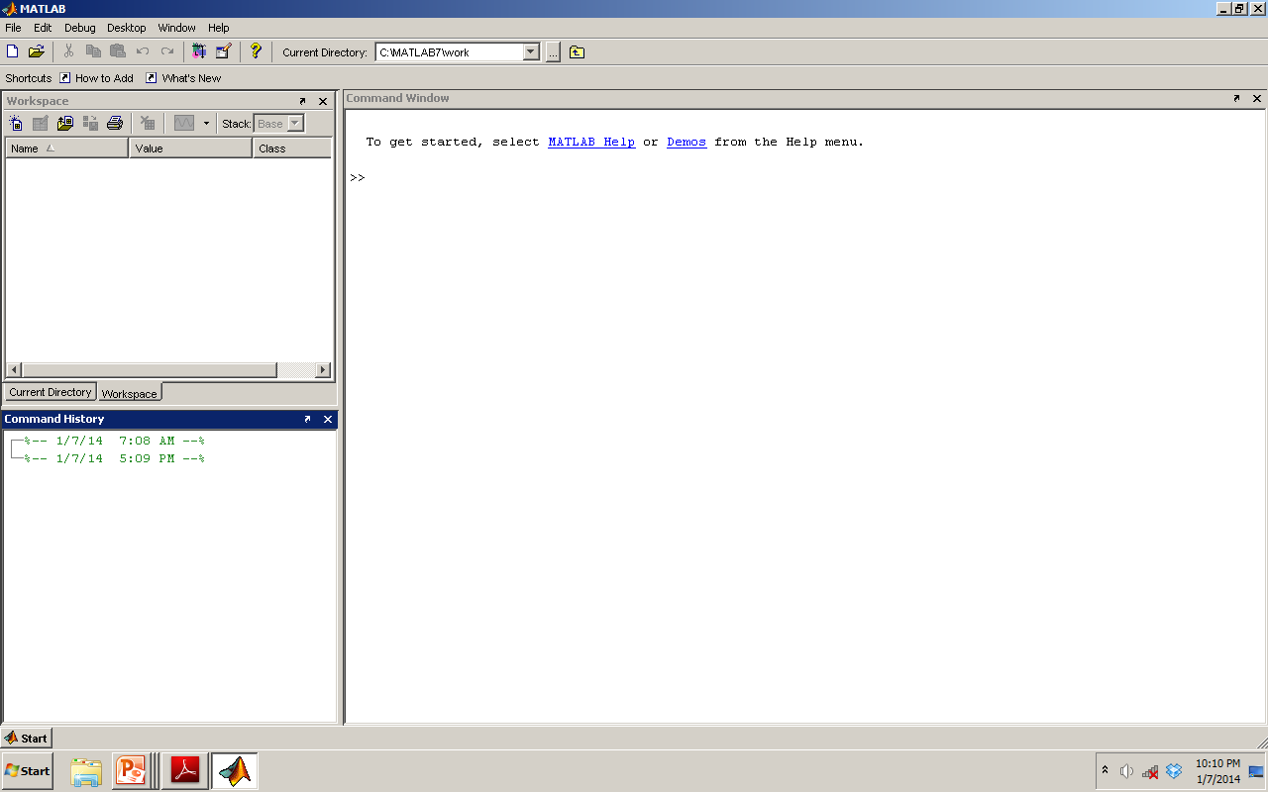
Display Windows
This is the work space, which list all the variables you are using
This is the command window, you can
enter commands and data and results are displayed here
This is the command history window, it displays a log of the command used.

Slide 6
Display Windows (con’t…)
Graphic (Figure) Window
Displays plots and graphs
Created in response to graphics commands.
M-file editor/debugger window
Create and edit scripts of commands called M-files.

Slide 7
Getting Help
Type one of following commands in the command window:
help – lists all the help topic
help topic – provides help for the specified topic
help command – provides help for the specified command
help help – provides information on use of the help command
helpwin – opens a separate help window for navigation
lookfor keyword – Search all M-files for keyword

Slide 8
Variables
Variable names:
Must start with a letter
May contain only letters, digits, and the underscore “_”
Matlab is case sensitive, i.e. one & OnE are different variables.
Assignment statement:
Variable = number;
Variable = expression;
Example:
>> tutorial = 1234;
>> tutorial = 1234
tutorial =
1234
NOTE: when a semi-colon ”;” is placed at the end of each command, the result is not displayed.

Slide 9
Variables (con’t…)
Special variables:
ans : default variable name for the result
pi: π = 3.1415926…………
eps: 𝟄 = 2.2204e-016, smallest amount by which 2 numbers can differ.
Inf or inf : infinity
NaN or nan: not-a-number
Commands involving variables:
who: lists the names of defined variables
whos: lists the names and sizes of defined variables
clear: clears all variables, reset the default values of special variables.
clear name: clears the variable name
clc: clears the command window
clf: clears the current figure and the graph window.

Slide 10
Vectors, Matrices and Linear Algebra
Vectors
Matrices
Array Operations
Solutions to Systems of Linear Equations.

Slide 11
Vectors
A row vector in MATLAB can be created by an explicit list, starting with a left bracket, entering the values separated by spaces (or commas) and closing the vector with a right bracket.
A column vector can be created the same way, and the rows are separated by semicolons.
Example:
>> x = [ 0 0.25*pi 0.5*pi 0.75*pi pi ]
x =
0 0.7854 1.5708 2.3562 3.1416
>> y = [ 0; 0.25*pi; 0.5*pi; 0.75*pi; pi ]
y =
0
0.7854
1.5708
2.3562
3.14

Slide 12
Vectors(con’t…)
Vector Addressing – A vector element is addressed in MATLAB with an integer index enclosed in parentheses.
Example:
>> x(3) 3rd elements of vector x
ans =
1.5708
The colon notation may be used to address a block of elements.
(start : increment : end)
start is the starting index, increment is the amount to add to each successive index, and end is the ending index. A shortened format
(start : end) may be used if increment is 1.
Example:
>> x(1:3) 1st to 3rd elements of vector x
ans =
0 0.7854 1.5708

Slide 13
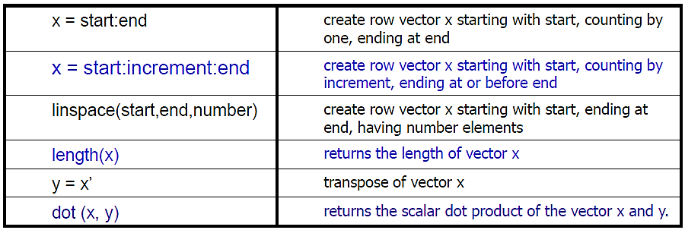
Vectors(con’t…)
Some useful commands

Slide 14
Matrices
A Matrix array is two-dimensional, having both multiple rows and multiple columns, similar to vector arrays:
it begins with [, and end with ]
spaces or commas are used to separate elements in a row.
semicolon or enter is used to separate rows.
Example:
>> f = [ 1 2 3; 4 5 6]
f =
1 2 3
4 5 6
>> h = [ 2 4 6
1 3 5]
h =
2 4 6
1 3 5

Slide 15
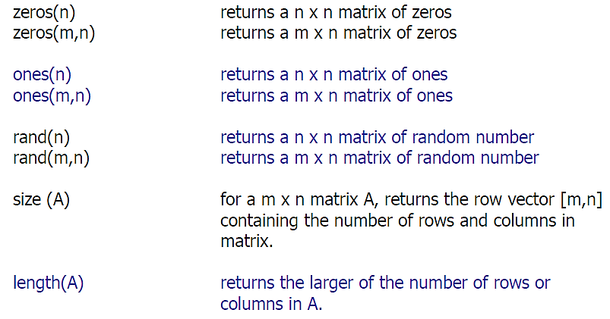
Matrices (con’t…)
Some useful commands

Slide 16
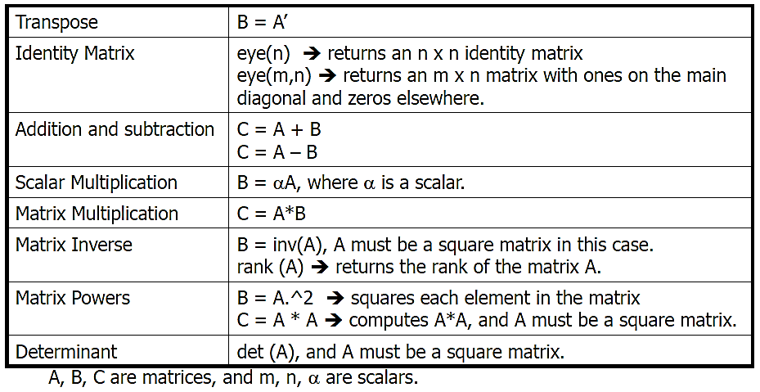
Matrices (con’t…)
More commands

Slide 17
Array Operations
Scalar-array Mathematics
For addition, subtraction, multiplication, and division of an array by a scalar simply apply the operations to all elements of the array.
Example:
>> f = [ 1 2; 3 4]
f =
1 2
3 4
>> g = 2*f – 1
g =
1 3
5 7
Each element in the array f is multiplied by 2, then subtracted by 1.

Slide 18
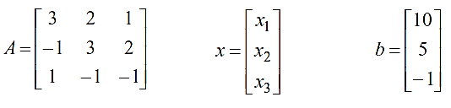
Solutions to Systems of Linear Equations
Example: a system of 3 linear equations with 3 unknowns (x1, x2, x3):
3x₁ + 2x₂ – x₃ = 10
- x₁ + 3x₂ + 2x₃ = 5
x₁ – x₂ – x₃ = -1
Let :
Then, the system can be described as:
Ax = b

Slide 19
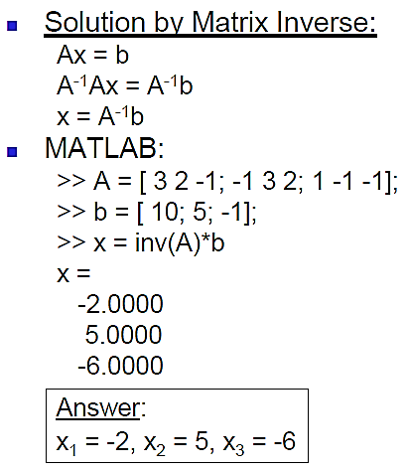
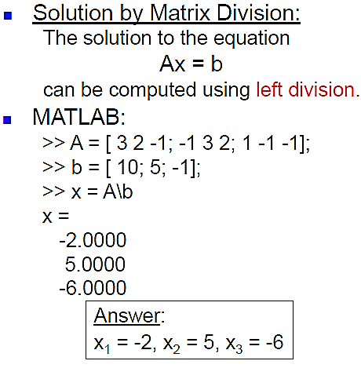
Solutions to Systems of Linear Equations

Slide 20
Plotting
For more information on 2-D plotting, type help graph2d
Plotting a point:
>> plot ( variablename, ‘symbol’)
Example : Complex number
>> z = 1 + 0.5j;
>> plot (z, ‘.’)
The function plot () creates a graphics window, called a Figure window, and named by default “Figure No. 1”

Slide 21
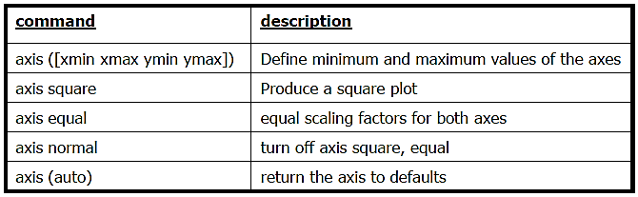
Plotting (con’t…)
Some useful commands

Slide 22
Plotting (con’t…)
Plotting Curves:
plot (x,y) – generates a linear plot of the values of x (horizontal axis) and y (vertical axis).
semilogx (x,y) – generate a plot of the values of x and y using a logarithmic scale for x and a linear scale for y
semilogy (x,y) – generate a plot of the values of x and y using a linear scale for x and a logarithmic scale for y.
loglog(x,y) – generate a plot of the values of x and y using logarithmic scales for both x and y

Slide 23
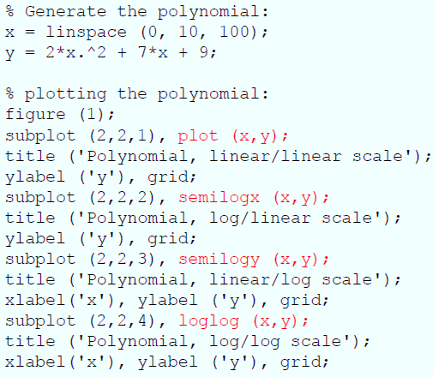
Plotting (con’t…)
Example: (polynomial function)
plot the polynomial using linear/linear scale, log/linear scale, linear/log scale, & log/log scale: y = 2x² + 7x + 9

Slide 24
Plotting (con’t…)
Example: (polynomial function)
plot the polynomial using linear/linear scale, log/linear scale, linear/log scale, & log/log scale: y = 2x² + 7x + 9

Slide 25
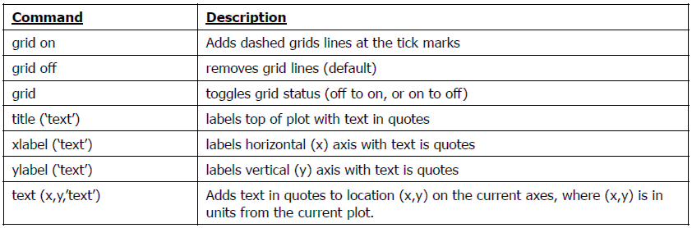
Plotting (con’t…)
Adding new curves to the existing graph:
Use the hold command to add lines/points to an existing plot.
hold on – retain existing axes, add new curves to current axes. Axes are rescaled when necessary.
hold off – release the current figure window for new plots
Grids and Labels:

Slide 26
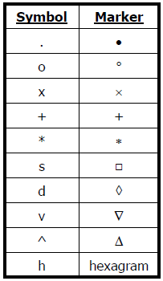
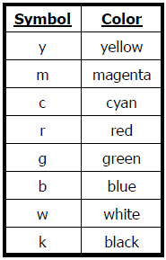
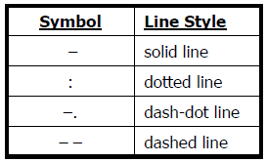
Additional commands for Plotting
color of the point or curve
Marker of the data points
Plot line styles

